Slide 1


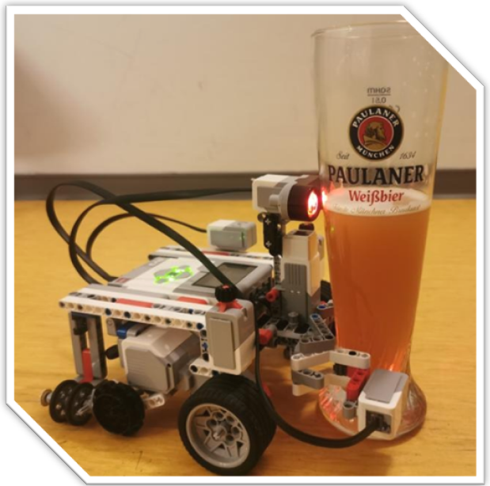
Sprint 3 Review
Lasting, efficient and fast bots
Product owner:
ENCARNACIÓN NÚÑEZ ORTEGA
SCRUM master:
LAURA PONCE OROZCO
Development team:
LAURA PONCE OROZCO
ENCARNACIÓN NÚÑEZ ORTEGA
FERLANDO MKIVA
Notes:
We updated a new product owner.

Slide 2

Goals in this sprint
As a user, I want the robot to immediately return to the starting point after collecting two fruits within 5 minutes.
As a developer, I want the robot to keep count of the harvested fruits.
As a user, I don’t want the robot to search for fruits outside the acre.
As a developer, I want the code to be efficient

Slide 3

Product Backlog
DONE
As a user, I want the robot to be completely autonomous
24
1
DOING
4
As a developer, I want the robot to keep count of the harvested fruits
As a user, I want the robot to ask me for the correct fruit and to confirm that it understood me
As a developer, I want the code to be efficient
1
4
2
As a user, I want the robot to immediately return to the starting point after collecting two fruits within 5 minutes
As a developer, I want the robot to be able to detect a 2.5cm cube
4
1
As a user, I don’t want the robot to search for fruits outside the acre
As a user, I want the robot to place the right fruit in the home zone
3
3
As a user, I don’t want the robot to return to the home zone without the fruit grabbed
As a user, I want the robot to look for the specified fruit and check if the fruit is correctly grabbed
4
5
Notes:
PONER COFFEES TOTALES

Slide 4
Velocity chart
13
12
8
4
0
Planned coffees
Finished coffees
11
We have underestimated the tasks
Expected
Done
SPRINT 1
SPRINT 2
SPRINT 3

Slide 5
Planned/Actual effort
As a developer, I want the robot to keep count of the harvested fruits.
1
1
As a user, I want the robot to immediately return to the starting point after collecting two fruits within 5 minutes.
Underestimated
4
5
Overestimated
As a user, I don’t want the robot to search for fruits outside the acre.
5
4
As a developer, I want the code to be efficient.
4
4

Slide 6
Burn-down charts
12
8
4
0
28
24
20
16
12
8
4
0
COFFEES
COFFEES
1 2 3 4 5 6 7
1 2 3
DAYS
SPRINTS

Slide 7

Test
Robot does not lose the fruit during approach on 8 different occasions.
The robot distinguish between correct and incorrect fruit saying “right” or “wrong” during 10 tests.
Tested with 5 different fruit positions.
Robot returns to the starting point with less than 20cm of difference, tested 6 times.
.
Notes:
.

Slide 8
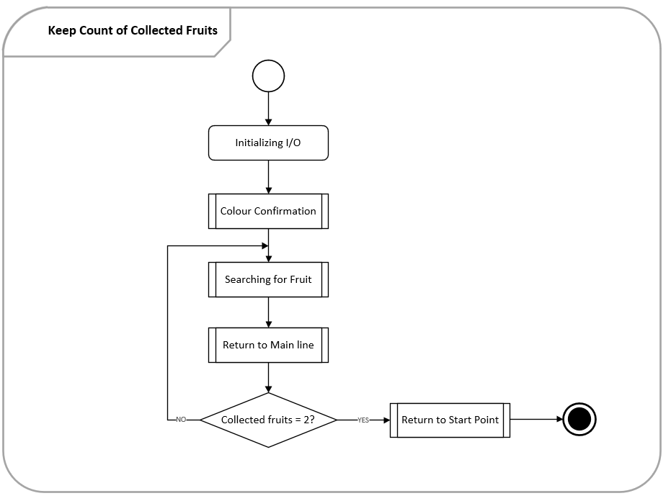
Activity Diagram

Slide 9
Activity Diagram

Slide 10
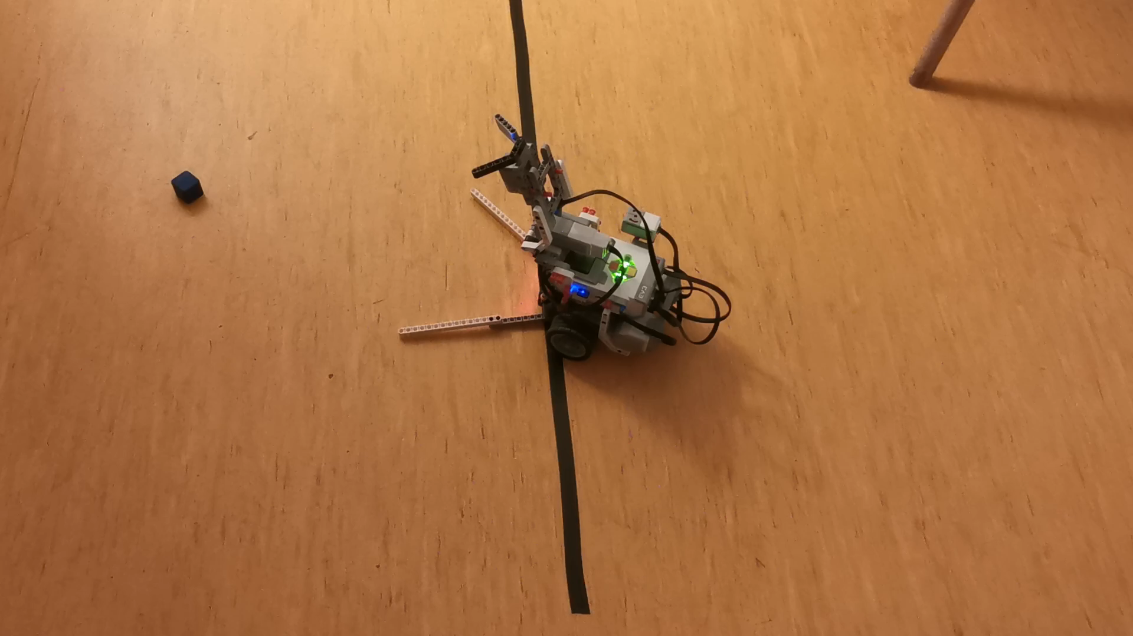
Demo

Slide 11
Retrospective
Lowlight
The motivation of the team decreased due to several errors regarding the sensors
Highlight
We started thinking outside of the box and eliminate negativity

Slide 12
SMART goal
Specific
Measurable
Achievable
Relevant
Time-Bound
Our goal is to increase our creativity and code quality by brainstorming for an hour, which we will do before developing each function idea.
We can achieve this by comparing the results we had previously with the final ones. Accomplishing this goal will result in improve outcomes and a better group mood with greater motivation.

